Slide 1
Cryo stop of P8 on 1st of November
Stop of warm compressor CP6 of QSCB on safety chain (oil differential pressure low) at 10:35AM
After investigation, problem of oscillations with the controller of 6CV670 which regulate the differential pressure of the oil injection of high stage compressors of the station LHCB
Problem of oscillations on this valve was already observed … and controller was due to be changed during next TS
New controller installed over lunch time
Restart of installations by 2PM
Recovery expected by Wednesday evening…

Slide 2
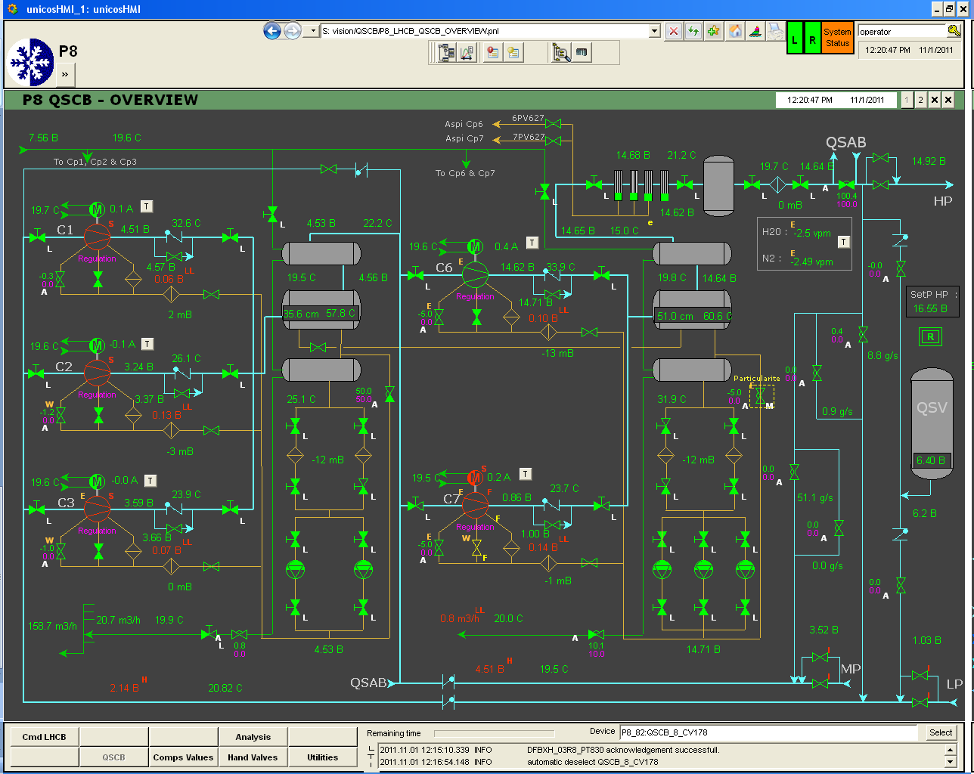
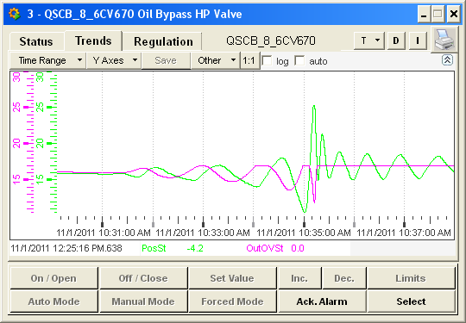
Problem (oscillations) with controller of 6CV670, which regulate ΔP of oil injection for compressor

Slide 3
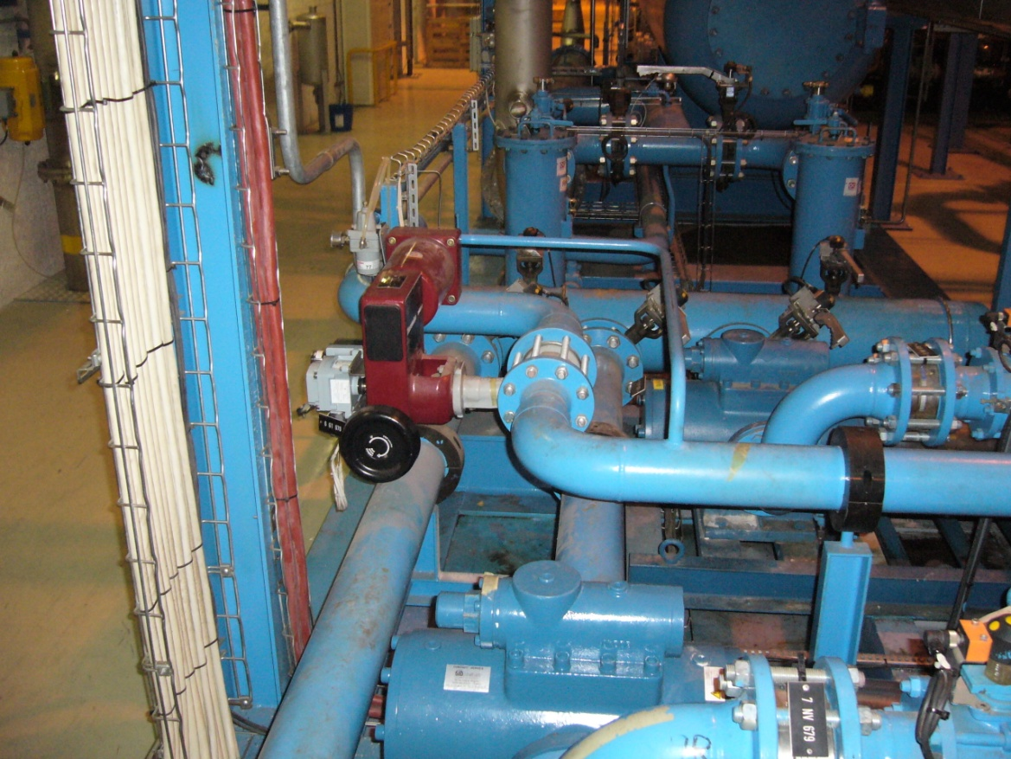
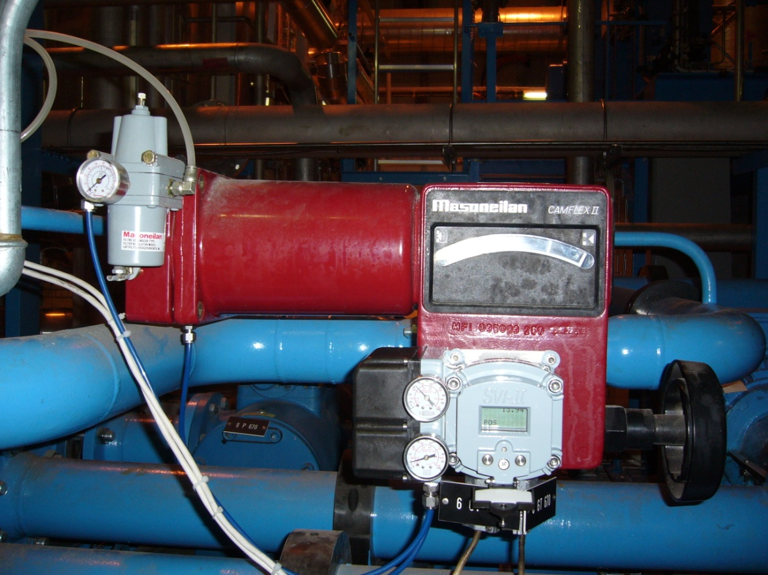
Cryo stop of P8 on 1st of November
Faulty controller
6CV670

